Slide 1
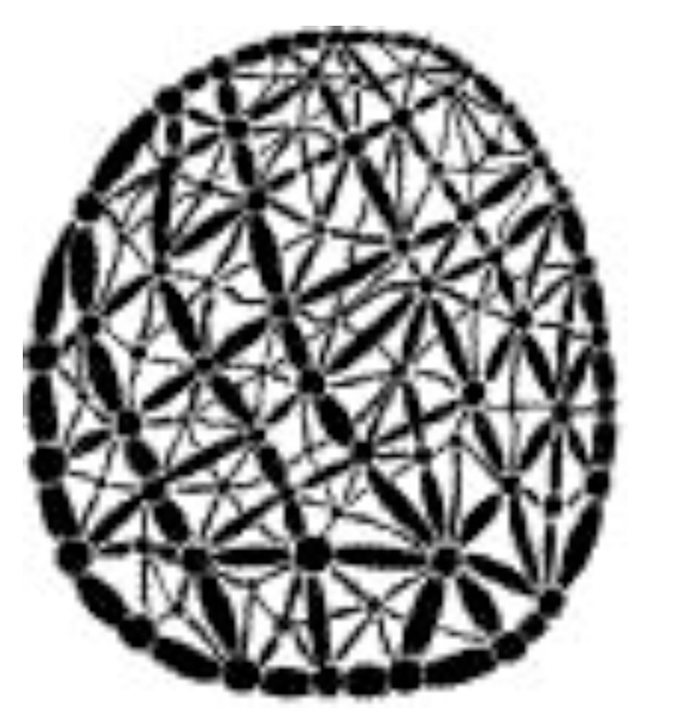

The centrality – lethality rule in signed protein networks
Interfaculty Master Program on
Complex Systems and Networks
Aristotle University of Thessaloniki
Student
Savas Paragamian
Thessaloniki, May 2017
Commitee
Supervisor
Stefanos Sgardelis
Prof. Biology AUTH
Co-supervisor
Ioannis Antoniou
Prof. Mathematics AUTH
Co-supervisor
Christoforos Nikolaou
Ass. Prof. Biology UOC

Slide 2
The aim of this study is to extend the centrality – lethality rule to signed protein interaction networks in order to improve the prediction of essential genes / proteins.

Slide 3
Questions
Does the centrality – lethality rule holds in the signed protein interaction network of D. melanogaster?
What kinds of interactions are connecting essential proteins?
Is essentiality modular in D. melanogaster?

Slide 4
Gene essentiality
A gene/protein is essential if and only if its removal or disruption results in lethality or infertility of the organism

Slide 5
History
Individual gene knock-out experiments
Lethal genes vs essential genes
Laborious task
Large scale gene essentiality screens in the 1990’s
Tatum, E. L., & Lederberg, J. (1947). Gene Recombination in the Bacterium Escherichia coli. Journal of Bacteriology, 53(6), 673–684.
Lu, L. J. (editor). (2015). Gene Essentiality Methods and Protocols. (L. J. Lu, Ed.). New York: Springer Science+Business Media.
Winzeler, E. A. (1999). Functional Characterization of the S. cerevisiae Genome by Gene Deletion and Parallel Analysis. Science, 285(5429), 901–906.

Slide 6
Origins and conservation
Lower mutation rates
Metabolic processes
Cell cycle processes
Non essentiality and redundancy
Jordan, I. K., Rogozin, I. B., Wolf, Y. I., & Koonin, E. V. (2002). Essential Genes Are More Evolutionarily Conserved Than Are Nonessential Genes in Bacteria. Genome Research, 12, 962–968.
Zhang, Z., & Ren, Q. (2015). Why are essential genes essential? - The essentiality of Saccharomyces genes. Microbial Cell, 2(8), 280–287.

Slide 7
Research interests
Minimal gene sets and synthetic biology
Human disease genes (impossible essentiality experiments)
Possible drug targets for pathogens (laborious experiments)
Hutchison, C. A., Chuang, R.-Y., Noskov, V. N., Assad-Garcia, N., Deerinck, T. J., Ellisman, M. H., … Venter, J. C. (2016). Design and synthesis of a minimal bacterial genome. Science, 351(6280), 6253–6253.

Slide 8
Current challenges of gene essentiality
Evolvability
Differential/ conditional essentiality
Modular essentiality in protein complexes, in general modular biology
Prediction
D’Elia, M. A., Pereira, M. P., & Brown, E. D. (2009). Are essential genes really essential? Trends in Microbiology, 17(10), 433–438.
Liu, G., Yong, M. Y. J., Yurieva, M., Srinivasan, K. G., Liu, J., Lim, J. S. Y., … Rancati, G. (2015). Gene Essentiality Is a Quantitative Property Linked to Cellular Evolvability. Cell, 163(6), 1388–1399.
Ideker, T., & Krogan, N. J. (2012). Differential network biology. Molecular Systems Biology, 8(565), 1–9.
Hartwell, L. H., Hopfield, J. J., Leibler, S., & Murray, A. W. (1999). From molecular to modular cell biology. Nature, 402(6761 Suppl), C47–C52.
Koch, C. (2012). Modular Biological Complexity. Science, 337(6094), 531–532.

Slide 9
Prediction of gene essentiality
Data availability
1990’s: Sequencing
Comparable genomics (DNA sequence homology tools, e.g BLAST)
Mushegian, A. R., & Koonin, E. V. (1996). A minimal gene set for cellular life derived by comparison of complete bacterial genomes. Proceedings of the National Academy of Sciences of the United States of America, 93(19), 10268–10273.
2000’s: Highthrouput experiments
Metabolomics
Proteomics
Network science emergence
Centrality – lethality rule
Types of networks : Protein interactions, metabolic, transcription regulation, gene expression
Jeong, H., Mason, S. P., Barabási, a L., & Oltvai, Z. N. (2001). Lethality and centrality in protein networks. Nature, 411(6833), 41–42.

Slide 10
Tools and R packages
Working enviroment
R Studio
Knitr
Rmarkdown
bookdown
Data cleansing and manipulation
readxl
readr
reshape2
dplyr
tidyr
Graphics and visualization
ggplot2
ggraph
scales
gridExtra
Network analysis
Igraph
Bipartite
Vegan
RBGL
Gene Ontology
AnnotationDbi
org.Dm.eg.db
GO.db
topGO
Analysis
Rpart
C50
ROCR: for evaluation
Entropy

Slide 11
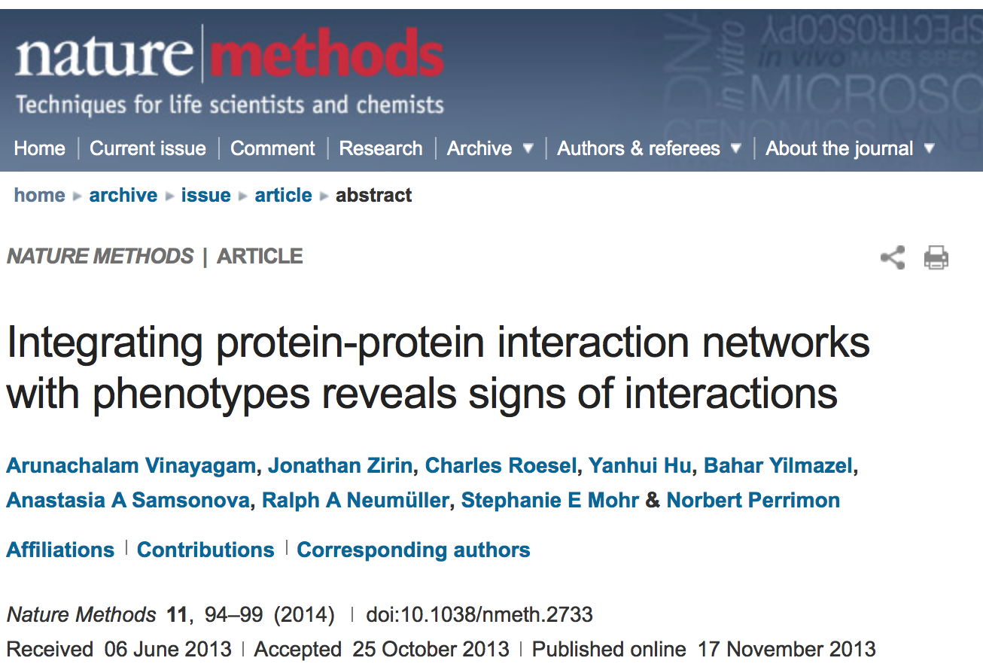
Signed PPI network of D. melanogaster

Slide 12
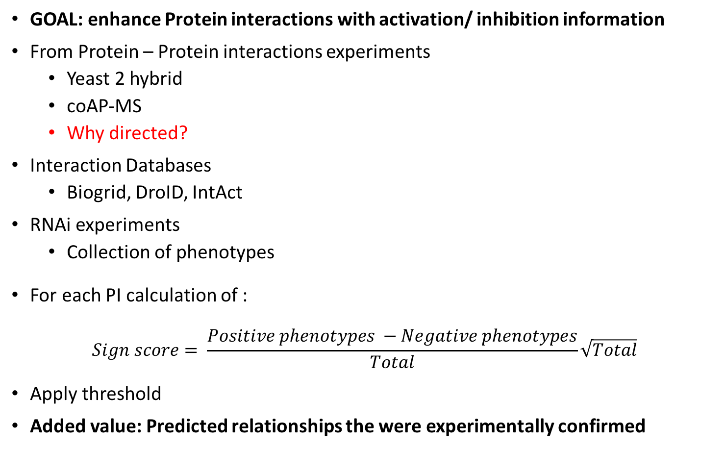
Signed PPI network of D. melanogaster
GOAL: enhance Protein interactions with activation/ inhibition information
From Protein – Protein interactions experiments
Yeast 2 hybrid
coAP-MS
Why directed?
Interaction Databases
Biogrid, DroID, IntAct
RNAi experiments
Collection of phenotypes
For each PI calculation of :
$$Sign score= \frac{Positive phenotypes −Negative phenotypes}{Total}\sqrt{Total}$$
Apply threshold
Added value: Predicted relationships the were experimentally confirmed

Slide 13
Signed PPI network of D. melanogaster

Slide 14
Signed PPI network of D. melanogaster
Type | All PI of D.melanogaster | Signed PI of D.melanogaster | Giant component
Proteins | 9107 | 3352 | 3058
Interactions | 47293 | 6094 | 5930
Positive | 0 | 4109 | 3998
Negative | 0 | 1985 | 1932

Slide 15

Consensus | All D.melanogaster | Complete network | Giant component
Nonessential | 13373 | 3009 | 2737
Essential | 267 | 154 + 33 conditional | 146 + 29 conditional
Conditional | 141 | 33 | 29
NA | 0 | 156 | 146
Total | 13781 | 3352 | 3058

Slide 16
Centralities : Network topology
High Degree : Hubs
High Betweenness : bottlenecks
They are correlated…
New centralities are constantly introduced
Joy, M. P., Brock, A., Ingber, D. E., & Huang, S. (2005). High-betweenness proteins in the yeast protein interaction network. Journal of Biomedicine and Biotechnology, 2005(2), 96–103.
Yu, H., Kim, P. M., Sprecher, E., Trifonov, V., & Gerstein, M. (2007). The importance of bottlenecks in protein networks: Correlation with gene essentiality and expression dynamics. PLoS Computational Biology, 3(4), 713–720.

Slide 17
Other network approaches
Use of other data: gene expression, metabolic interactions…
Naïve Bayes
Weighted k-nearest neighbors
Logistic regression
Decision trees
Etc...
Integration of methods : Best results!
Zhang, X., Acencio, M. L., & Lemke, N. (2016). Predicting essential genes and proteins based on machine learning and network topological features: A comprehensive review. Frontiers in Physiology, 7(MAR), 1–11
Jalili, M., Salehzadeh-Yazdi, A., Gupta, S., Wolkenhauer, O., Yaghmaie, M., Resendis-Antonio, O., & Alimoghaddam, K. (2016). Evolution of Centrality Measurements for the Detection of Essential Proteins in Biological Networks. Frontiers in Physiology, 7(August), 375.

Slide 18
Decision trees
Predicted condition | C5.0 | rpart | C4.5 RWeka
True positives | 22 | 23 | 21
False negatives | 124 | 123 | 125
False positives | 4 | 5 | 1
True negatives | 2762 | 2761 | 2765
Precision | 0.846 | 0.821 | 0.955
Recall | 0.151 | 0.158 | 0.144
C4.5 RWeka
C5.0

Slide 19
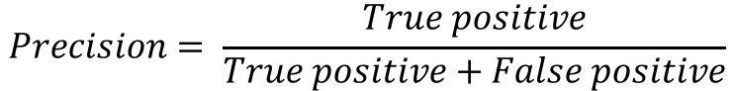
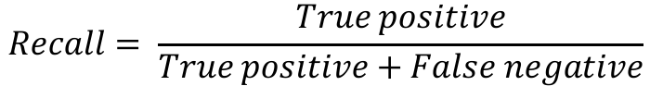
Centrality – Lethality rule : Results
$$Precision= \frac{True positive}{True positive+False positive}$$
$$Recall= \frac{True positive}{True positive+False negative}$$

Slide 20
Centrality – Lethality rule : Results

Slide 21
Centrality – Lethality rule : Results

Slide 22
Centrality – Lethality rule : Challenges
More data, more enriched data
Gene expression, activation/inhibition, phenotype/genotype, transcription regulation, metabolic processes
Tools that can make use of that data
Best results -> Complex centrality : centrality index that incorporates protein complex information
Centralities for signed networks
Is this an artifact of the extensive work on essential genes?
Jalili, M., Salehzadeh-Yazdi, A., Gupta, S., Wolkenhauer, O., Yaghmaie, M., Resendis-Antonio, O., & Alimoghaddam, K. (2016). Evolution of Centrality Measurements for the Detection of Essential Proteins in Biological Networks. Frontiers in Physiology, 7(August), 375.

Slide 23
Interactions between essential proteins
Zotenko, E., Mestre, J., O’Leary, D. P., & Przytycka, T. M. (2008). Why do hubs in the yeast protein interaction network tend to be essential: Reexamining the connection between the network topology and essentiality. PLoS Computational Biology, 4(8).

Slide 24
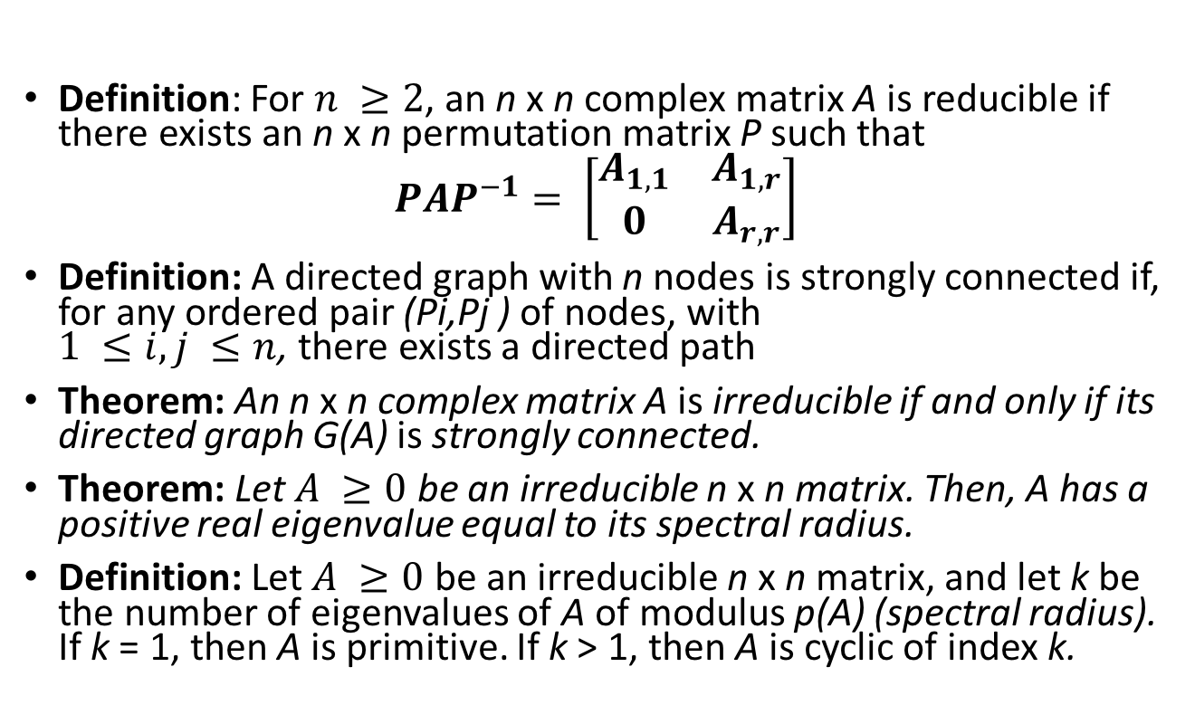
Perron – Frobenius decomposition
Definition: For $n ≥2$, an n x n complex matrix A is reducible if there exists an n x n permutation matrix P such that
$$PAP^{−1}= \left[\begin{matrix}A_{1,1} & A_{1,r} \\ 0 & A_{r,r}\end{matrix}\right]$$
Definition: A directed graph with n nodes is strongly connected if, for any ordered pair (Pi,Pj ) of nodes, with $1 ≤i,j ≤n$, there exists a directed path
Theorem: An n x n complex matrix A is irreducible if and only if its directed graph G(A) is strongly connected.
Theorem: Let $A ≥0$ be an irreducible n x n matrix. Then, A has a positive real eigenvalue equal to its spectral radius.
Definition: Let $A ≥0$ be an irreducible n x n matrix, and let k be the number of eigenvalues of A of modulus p(A) (spectral radius). If k = 1, then A is primitive. If k > 1, then A is cyclic of index k.
Tarjan, R. (1971). Depth-first search and linear graph algorithms. 12th Annual Symposium on Switching and Automata Theory (Swat 1971), 1(2), 146–160.
Carey V, Long L and Gentleman R (2017). RBGL: An interface to the BOOST graph library. R package version 1.52.0, http://www.bioconductor.org.
Varga, R. S. (2000). Matrix Iterative Analysis. (H. Yserentant, R. Bank, R. L. Graham, J. Stoer, & R. Varga, Eds.) (2nd edition). Heidelberg: Springer-Verlag.

Slide 25
Perron – Frobenius decomposition
All essential in giant component | 146 + 29 conditional
Connected essential cluster | 36 proteins, 243 links
Irreducible component | 20 proteins, 118 links

Slide 26
Perron – Frobenius decomposition
Components | 17 (16 singular)
Irreducible component | 20 proteins, 118 links
Perron–Frobenius eigenvalue of strongly connected component | 4.0210
k | 1

Slide 27
Singular enrichment analysis
Gene universe : Network proteins
Fishers’ exact test
58 significant GO terms
23 with FDR
21 with Bonferroni correction
Controversy:
Genes probabilities are not equal
Heavy tail distribution of the genes’ GO term membership
Ashburner, M., Ball, C. A., Blake, J. A., Botstein, D., Butler, H., Cherry, J. M., … Sherlock, G. (2000). Gene Ontology: tool for the unification of biology. Nature Genetics, 25(1), 25–29.
Adrian Alexa and Jorg Rahnenfuhrer (2016). topGO: Enrichment Analysis for Gene Ontology. R package version 2.26.0.
Glass, K., & Girvan, M. (2014). Annotation enrichment analysis: an alternative method for evaluating the functional properties of gene sets. Scientific Reports, 4, 4191.

Slide 28
Functional enrichment analysis
4 processes
Protein catabolism
Proteasome subunits
ATPase
Ubiquitin action
Response to stress
ATP biosynthesis
Hydrogen membrane transport
Cell cycle G1/S transition

Slide 29
Cooperation – Synergy
Essential proteins tend to form highly connected clusters rather than function independently (Zotenko et al. 2008).
Network population evolution model showed that selection favors cooperation interactions (Jain and Krishna, 2001)
Autocatalytic sets theory: An ACS is a subgraph, each of whose nodes has at least one incoming link from a node belonging to the same subgraph (S. A. Kauffman 1993)
In (Solé 2011): Cooperation has been suggested as an essential step toward the emergence of complex, self- organized chemical systems (Eigen 1971)
Jain, S., & Krishna, S. (2001). A model for the emergence of cooperation, interdependence, and structure in evolving networks. Pnas, 98(2), 543–7.
Kauffman, S. A. (1993). The Origins of Order Self-Organization and Selection in Evolution. New York: Oxford University Press.
Sole, R. V. (2011). Phase Transitions. Princeton: Princeton University Press.
Corning, P. A. (1995). Synergy and Self-Organization. Systems Research, 12(2), 89–121.

Slide 30
Interactions between essential proteins
Examine their signed interactions in other organisms
Other ideas for analysis…
Maybe there are missing inhibition interactions…

Slide 31
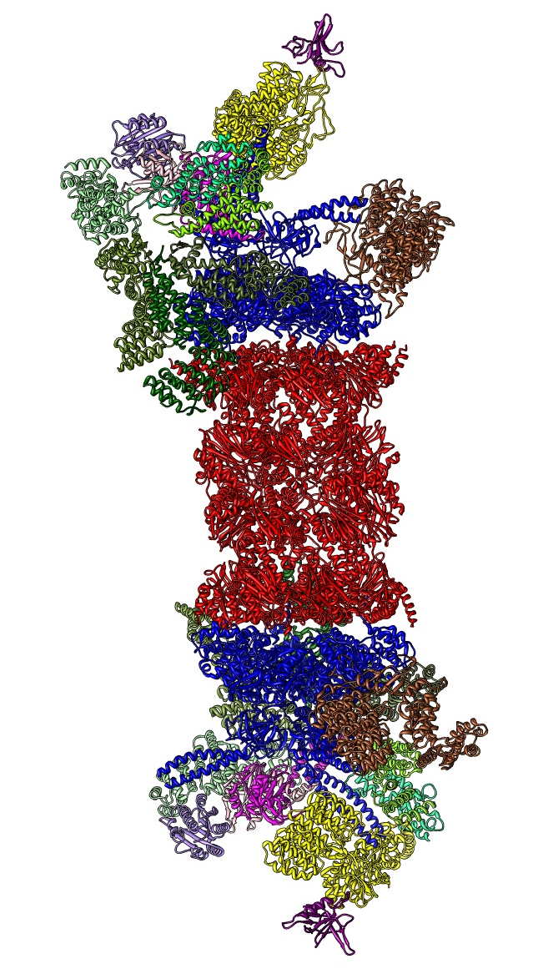
Modular essentiality
Proteins form complexes to function
Databases: Compleat, DPiM, CYT2008, MIPS
What is the distribution of essential proteins in complexes?
Pu, S., Wong, J., Turner, B., Cho, E., & Wodak, S. J. (2009). Up-to-date catalogues of yeast protein complexes. Nucleic Acids Research, 37(3), 825–831.
Guruharsha, K G; Rual, JF; Zhai, B; Mintseris, J; Vaidya, N; Beekman, C; Wong, C; Rhee, DY; Cenaj, O; McKilli[, E; Shah, S; Spatleton, M; Wan, KH; Yu, CH; Artavanis-Tsakonas, S. (2011). A Protein Complex Network of Drosophila melanogaster. Cell, 147(3), 690–703.
Mitra, K., Carvunis, A.-R., Ramesh, S. K., & Ideker, T. (2013). Integrative approaches for finding modular structure in biological networks. Nature Reviews Genetics, 14(10), 719–732.

Slide 32
Protein complexes as communities
Non-overlapping : Modularity
Overlapping : Link clustering
Ahn, Y.-Y., Bagrow, J. P., & Lehmann, S. (2010). Link communities reveal multiscale complexity in networks. Nature, 466(7307), 761–764.
Kalinka, A. T., & Tomancak, P. (2011). linkcomm: An R package for the generation, visualization, and analysis of link communities in networks of arbitrary size and type. Bioinformatics, 27(14), 2011–2012.
Nepusz, T., Yu, H., & Paccanaro, A. (2012). Detecting overlapping protein complexes in protein-protein interaction networks. NATURE METHODS, 9(5)
Ou-Yang, L., Dai, D. Q., & Zhang, X. F. (2015). Detecting Protein Complexes from Signed Protein-Protein Interaction Networks. IEEE/ACM Transactions on Computational Biology and Bioinformatics, 12(6), 1333–1344.

Slide 33
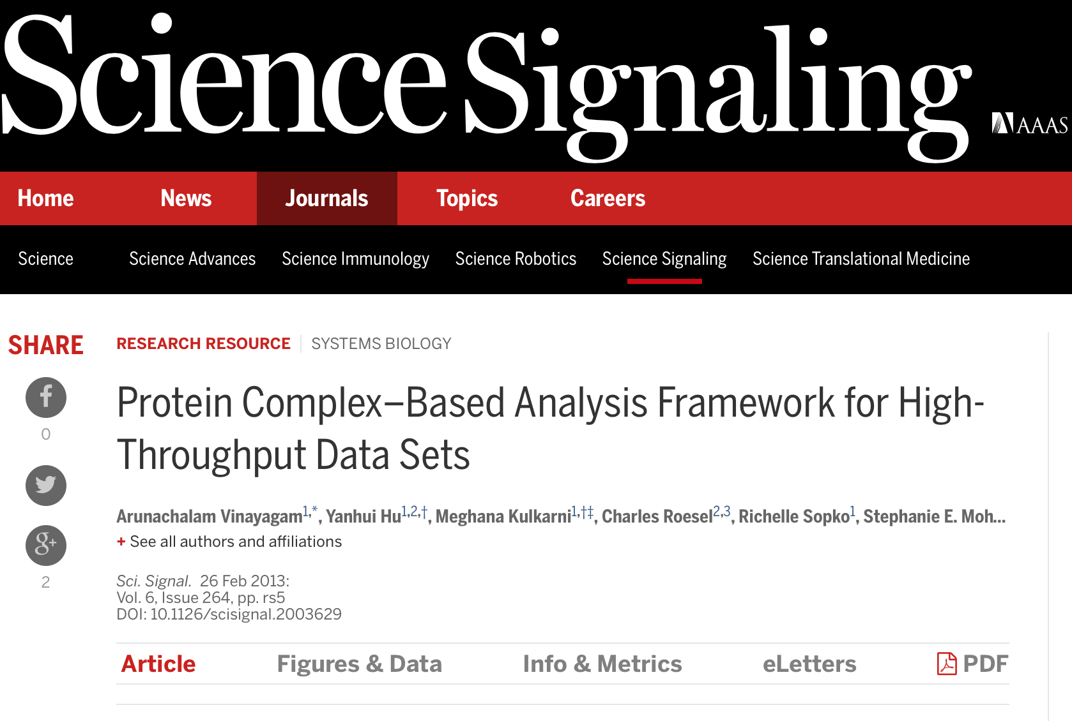
Compleat database

Slide 34
Compleat database distributions

Slide 35
Compleat database D. melanogaster
Source | Complexes | Proteins
Literature (326 distinct experiments) | 2045 | 4501
NetworkBlast | 2893 | 3525
CFinder | 389 | 1362
Total | 5327 | 5786
Bias due to authors’ implementation
or
due to NetworkBlast algorithm?

Slide 36
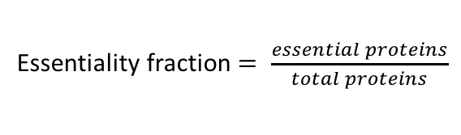
Complex essentiality fraction
Essentiality fraction $= \frac{essential proteins}{total proteins}$
Essentiality fraction | Literature Complexes
(0,0.2] | 1907
(0.2,0.4] | 90
(0.4,0.6] | 37
(0.6,0.8] | 9
(0.8,1] | 1

Slide 37
Size and essentiality fraction

Slide 38
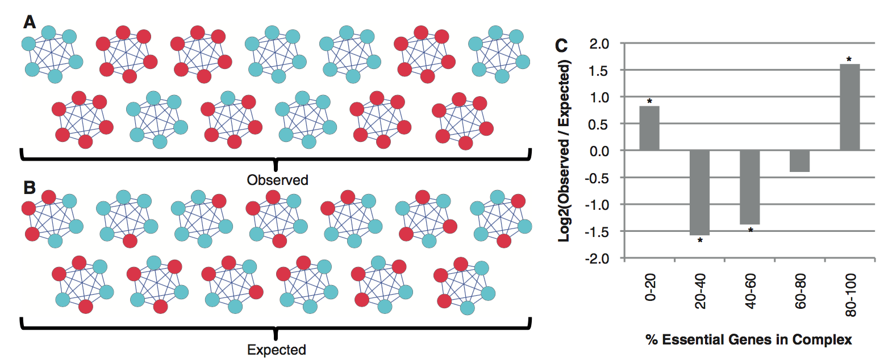
All or nothing hypothesis : Yeast
Hart, G. T., Lee, I., & Marcotte, E. R. (2007). A high-accuracy consensus map of yeast protein complexes reveals modular nature of gene essentiality. BMC Bioinformatics, 8, 236.
Ryan, C. J., Krogan, N. J., Cunningham, P., & Cagney, G. (2013).
All or nothing: Protein complexes flip essentiality between distantly related eukaryotes.
Genome Biology and Evolution, 5(6), 1049–1059.

Slide 39
All or nothing hypothesis : D. melanogaster

Slide 40
Challenges
Network contraction with complexes to represent biological processes in networks
Better complex prediction algorithms
Advancement of experimental methods for better and cheaper complex detection

Slide 41
Summary
Centrality – lethality is valid (although weaker) in the signed PPI network of D. melanogaster
Essential proteins form a cluster with activation (positive) interactions with functions:
ATP synthesis
Proteolysis
Hydrogen membrane transport
cell cycle G1/S phase transition
Modular essentiality is statistically significant in D. melanogaster
COMPLEAT database has bias towards big complexes
Data and method integration provides better results

Slide 42
Next steps
Generalization of the centrality indices for signed networks
Construction of large scale activation / inhibition protein networks for more organisms
Advancement of experimental and computational methods for the construction of complexes interaction network
Network dynamics and temporality of link activation

